Slide 1
PATTERN MATCHING
Abhishek Kumar (2K19/CO/020)
Abhishek Kumar Singh (2K19/CO/021)

Slide 2
USING AUTOMATA THEORY FOR PATTERN MATCHING
Automata Theory is found useful in many high level programming languages. It can be applied for the evaluation of regular expressions. Pattern matching requires a complicated model, with a different programmatic approach. There are many techniques available for pattern matching process that is memory efficient which reduces the size of Deterministic finite automata. Finite Automata is used in pattern matching process to represent the patterns. To make it memory efficient we can minimize the number of states, minimize number of transitions. In this paper we present a new automata-based approach for pattern matching. We use a macro that takes a grammar and generates a function that reads off the leaves of a tree and tries to parse them as a string in a context-free language. The experimental results indicate that this approach is a tool for pattern matching.

Slide 3
INTRODUCTION
Finite automata
A model of computation composed of states, a transition function, and an input alphabet.
Finite State Machine
An automaton (in automata theory) is a 5-tuple (Q, Σ, δ, q₀, F) defined as following:
• Q – Finite set of states
• Σ – Alphabet
• δ – Transition function (δ: Q × Σ → Q)
• q₀ – First (starting) state
• F – Set of finishing (accept) states
Pattern Matching
It is the act of checking a given sequence of tokens for the presence of the constituents of some pattern. Transition function It describes a condition that has to be fulfilled to enable the transition

Slide 4
Algorithm of Pattern Matching
An automaton is a machine that scans a string and either accepts it or rejects it. The string is accepted if the automaton reaches the finishing (accept) state after "reading" it. "Reading" the string is done one symbol at a time and using the transition function determine what the next state will be. If the automaton is not in an accept state at the end, the string gets declined. Finite automata can be divided into two subgroups. Automata can be either deterministic (DFA) or nondeterministic (NFA). DFA is deterministic; meaning the transition from one state to another is unique. In NFA transition in the automaton can go from one state to several different states by "reading" only one symbol. finite automata is usually represented by a directed graph where arrows represent the transition function.
There are two commonly used algorithms for pattern matching:
i. Knuth-Morris-Pratt (KMP) Algorithm
ii. Rabin-Karp Algorithm
Both the algorithms make use of similar method. The complexity of the algorithms take linear time: O(m + n) where m is the length of the string, and n is the length of the file.

Slide 5
What is Plagiarism?
It is the act of Academic stealing some others work such as copying words from a book or a scientific paper and publish it as it's his work, also stealing the ideas, images, videos, and music and using them without permission or providing a proper citation is called plagiarism.
Now the Blogs such as Facebook Pages and some websites are copying and pasting information violating many copyrights, so many tools are used to prevent plagiarism such as disabling the right click to prevent copying. also placing copyright warning on every page in the website as banners or pictures. And the use of DCMA copyright law to report for copyright infringement and the violation of copyrights, this report could be sent to the website owner or the ISP hosting the website and the website/content will be removed.
Plagiarism on the Internet

Slide 6
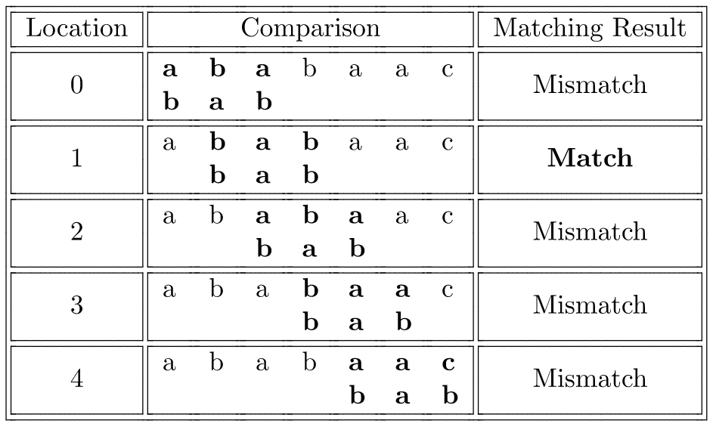
Rabin-Karp Algorithm
Rabin-Karp algorithm is an algorithm used for searching/matching patterns in the text using a hash function. Unlike Naive string matching algorithm, it does not travel through every character in the initial phase rather it filters the characters that do not match and then performs the comparison

Slide 7
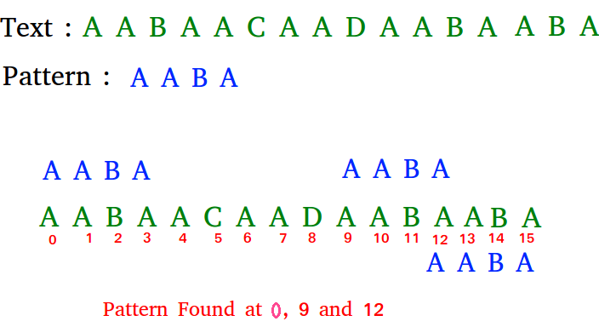
Knuth-Morris-Pratt Algorithm
Knuth Morris Pratt (KMP) is an algorithm, which checks the characters from left to right. When a pattern has a sub-pattern appears more than one in the sub-pattern, it uses that property to improve the time complexity, also for in the worst case.

Slide 8
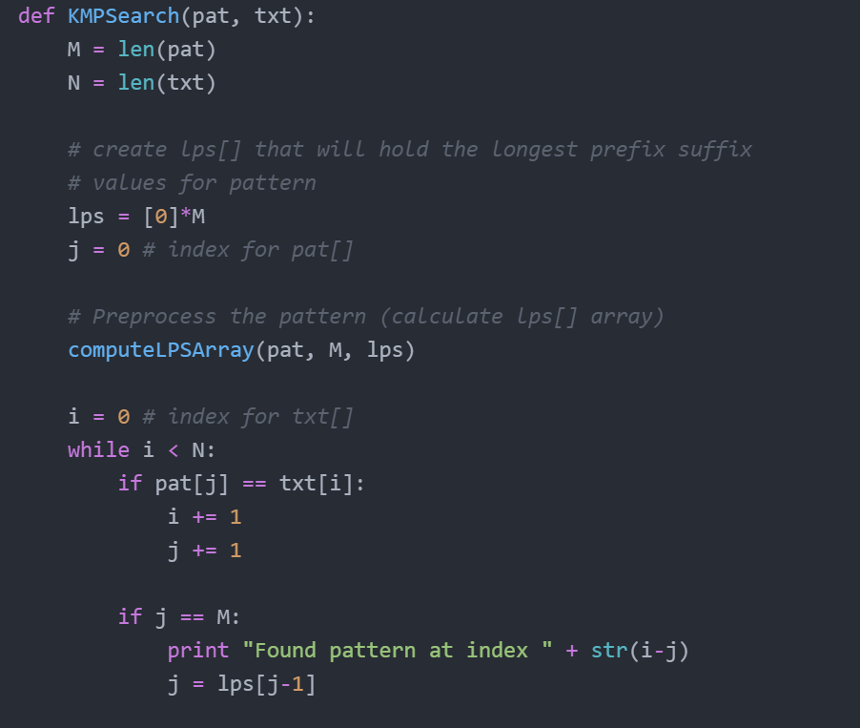
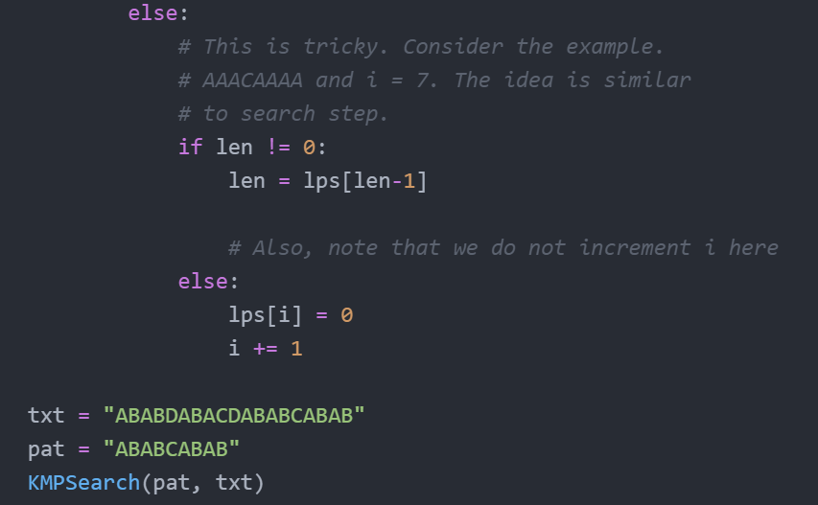
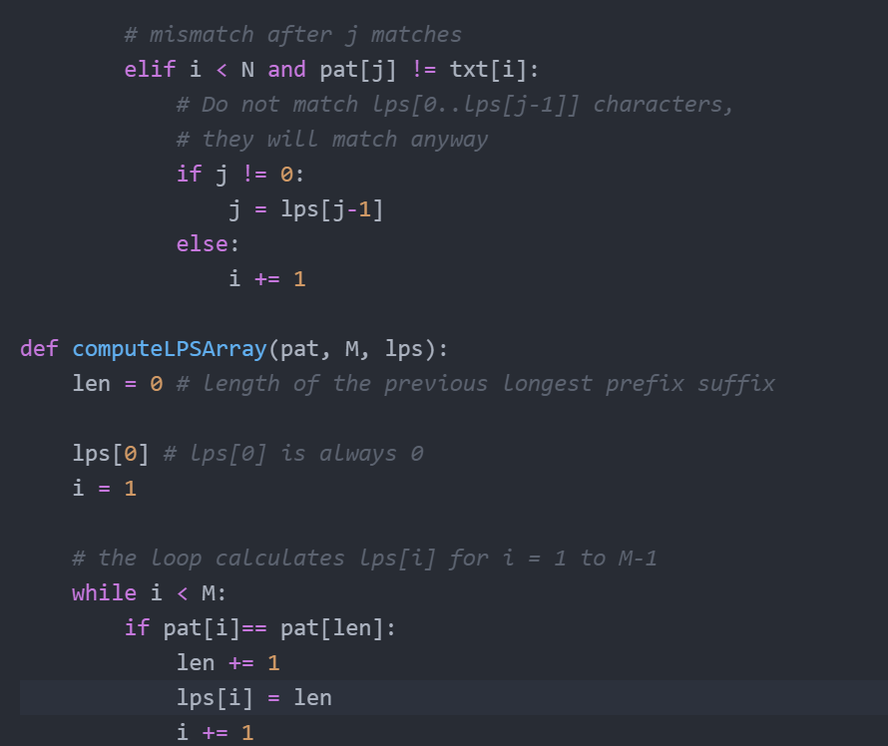
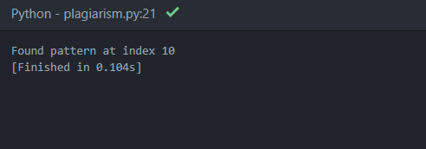

Slide 9
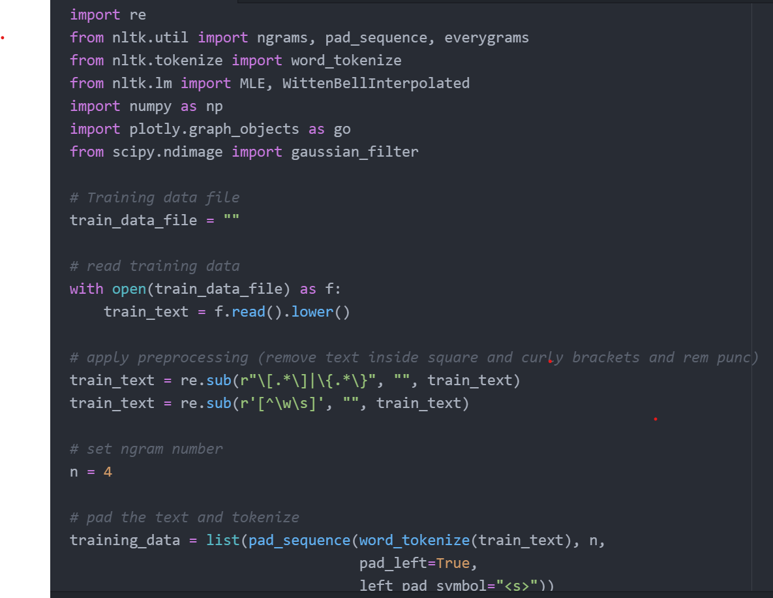
N-GRAM LANGUAGE MODEL
A language model is a statistical model that captures relevant linguistic features of the corpus on which it is trained. At a basic level, it should capture the frequency distribution of letters and words. An N-gram language model scores words based on the preceding window of context.
Following are the basic steps for training a language model:
Read in and pre-process a training data file i.e., remove punctuations, casing etc.
Tokenize the training data i.e., separate into individual words.
Generate n-grams from the training data using nltk.ngrams (trigrams in this case).

Slide 10
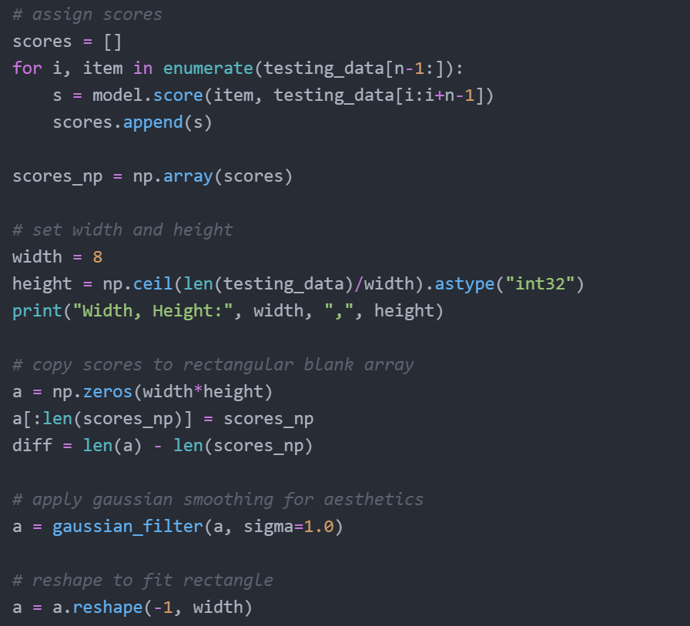
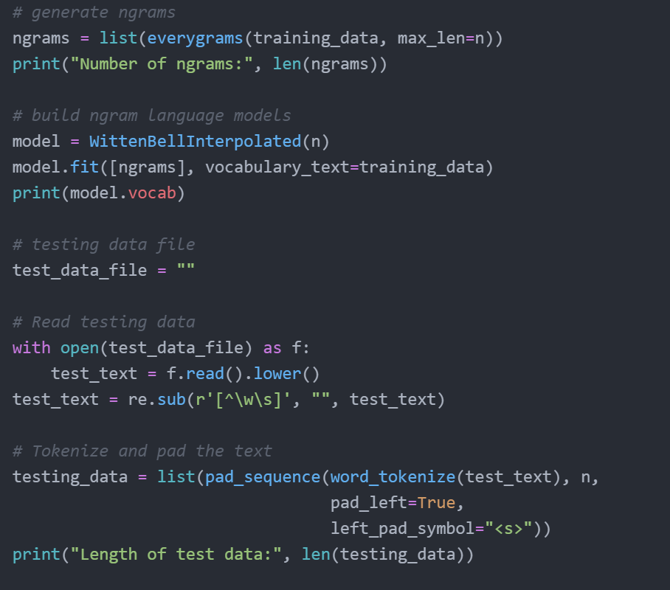
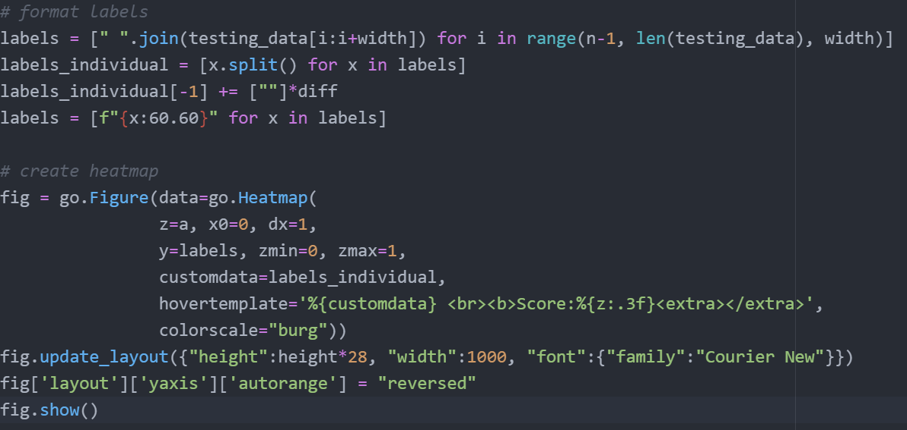

Slide 11
Procedure…

Slide 12
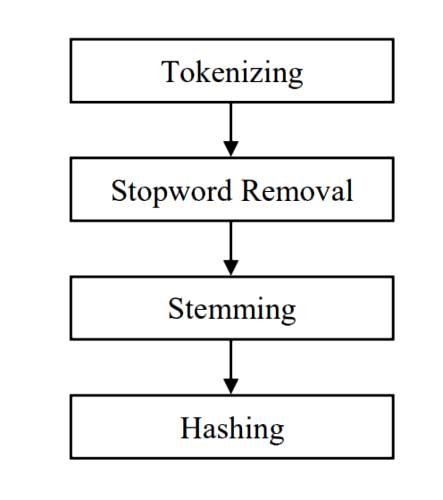
1. Text Pre-processing
Text pre-processing means providing your text in a form that is predictable and analyzable for your task. We do the pre-processing of both texts. Steps involved in text pre-processing such as tokenizing, stop-word removal, and stemming.

Slide 13
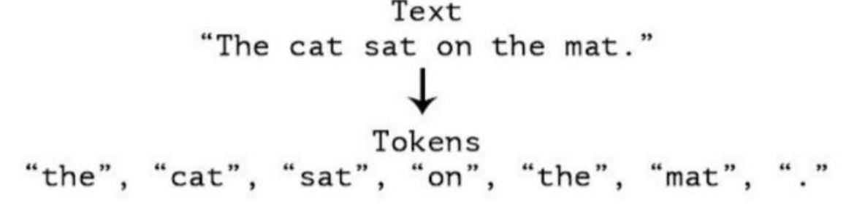
2. Tokenization
In this, we convert a document into a collection of words by entering the words in an array and separating the punctuation and numbers that are not included in the important words. This process will also change to lower case.

Slide 14
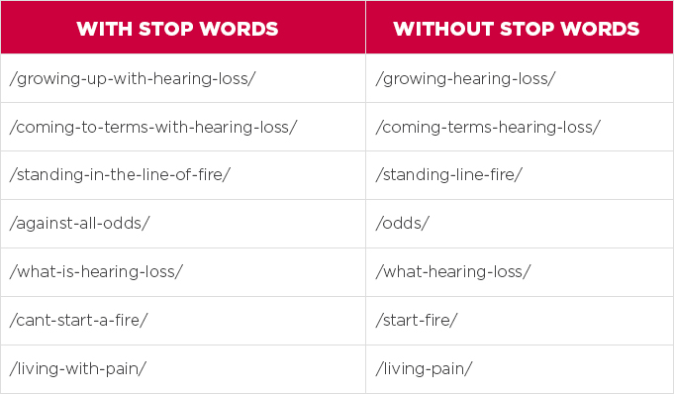
3. Stop-word Removal
Stop-word means all the common words present in natural language. Basically, the Stop-word Removal function removes all the common words present in the document such as "the”, “is”, “in”, “for”, “where”, “when”, “to”, “at” etc.

Slide 15
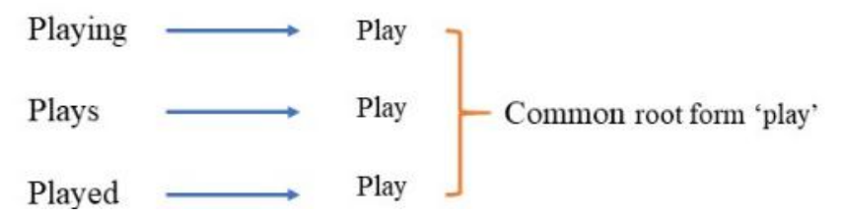
4. Stemming
Stemming is a process used to extract the base form of the words by removing affixes from them. It is just like cutting down the branches of a tree to its stems. For example, the stem of the words taking, took, takes is take.

Slide 16
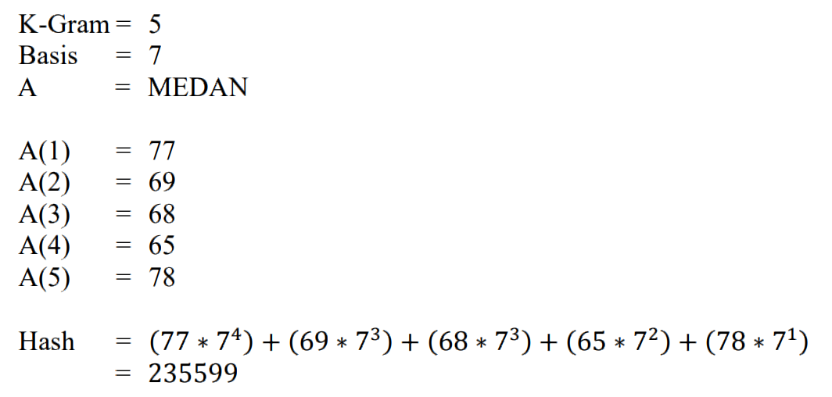
5. Hashing
Hashing is the most important value in the Rabin-Karp algorithm. The result of hashing letters of k-gram with a certain number of bases is obtained by multiplying the ASCII value with predetermined numbers where the base is prime. Rabin-Karp method has provisions if two strings are same then the hash value must be the same as well. Here is an example calculation on Rabin-Karp algorithm. Assume the text is MEDAN.

Slide 17
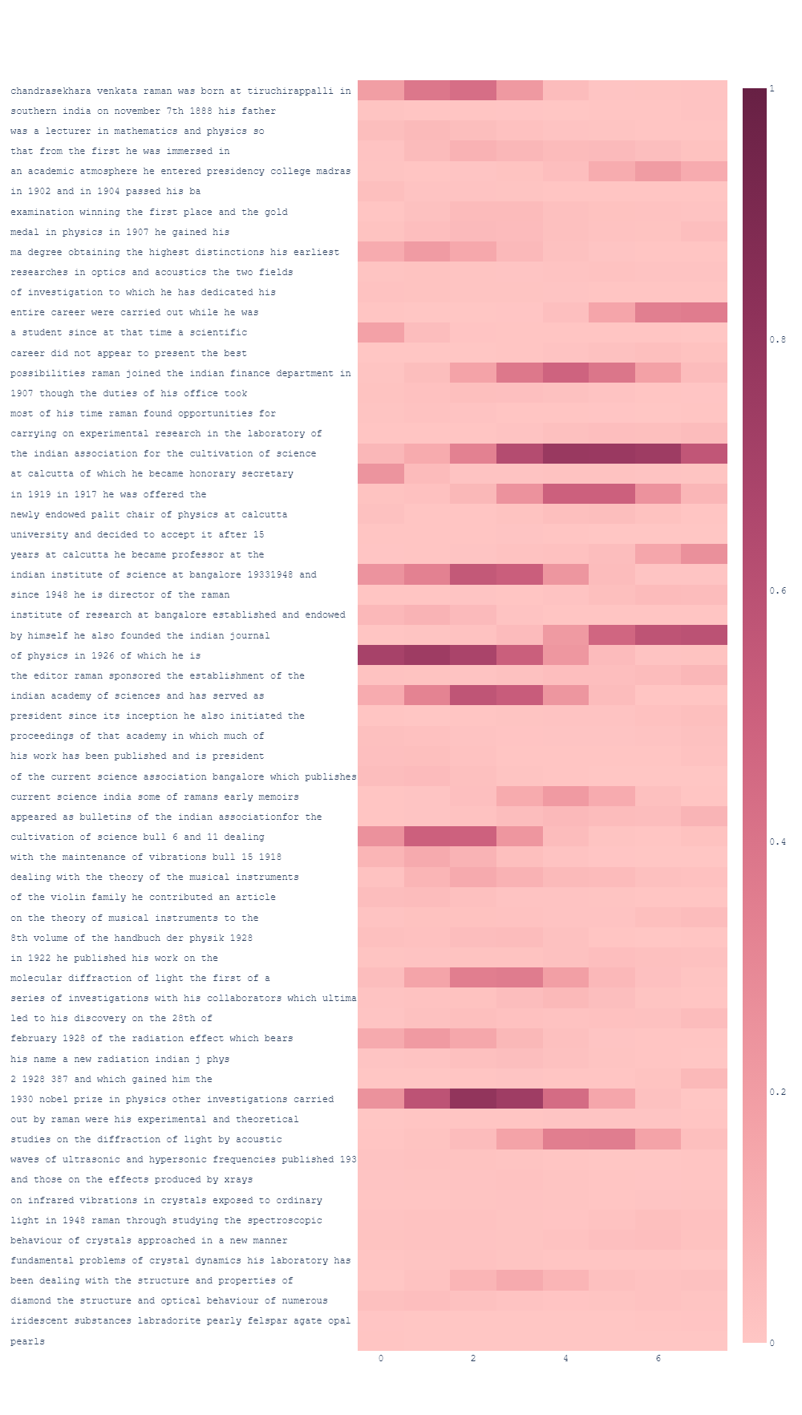
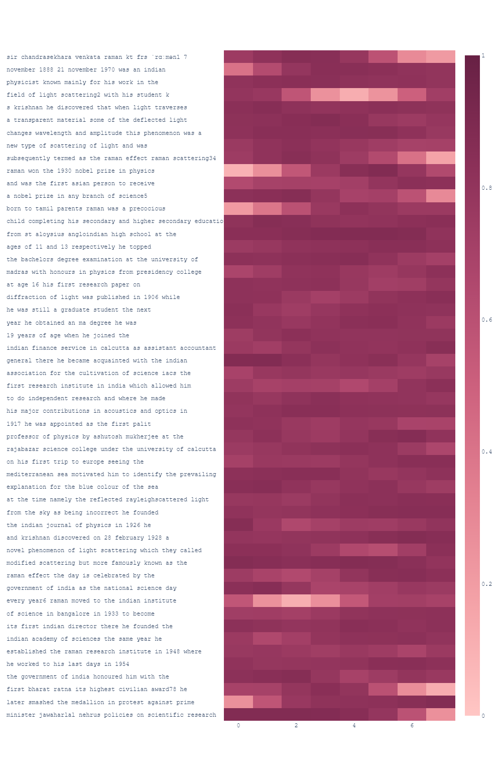
RABIN-KARP RESULTS
NON-
PLAGIARIZED EXAMPLE
PLAGIARIZED EXAMPLE

Slide 18
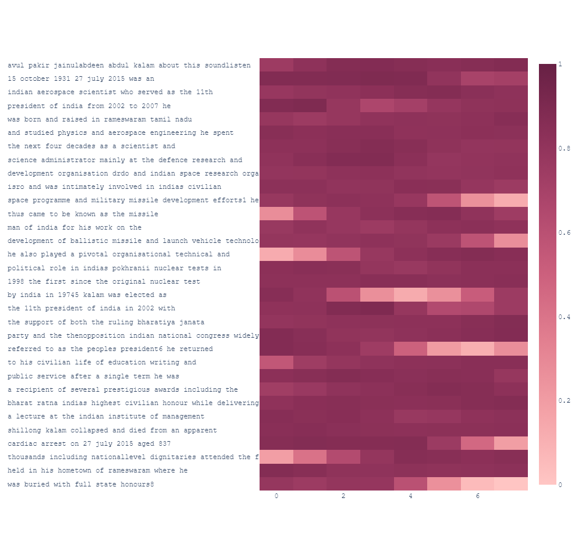
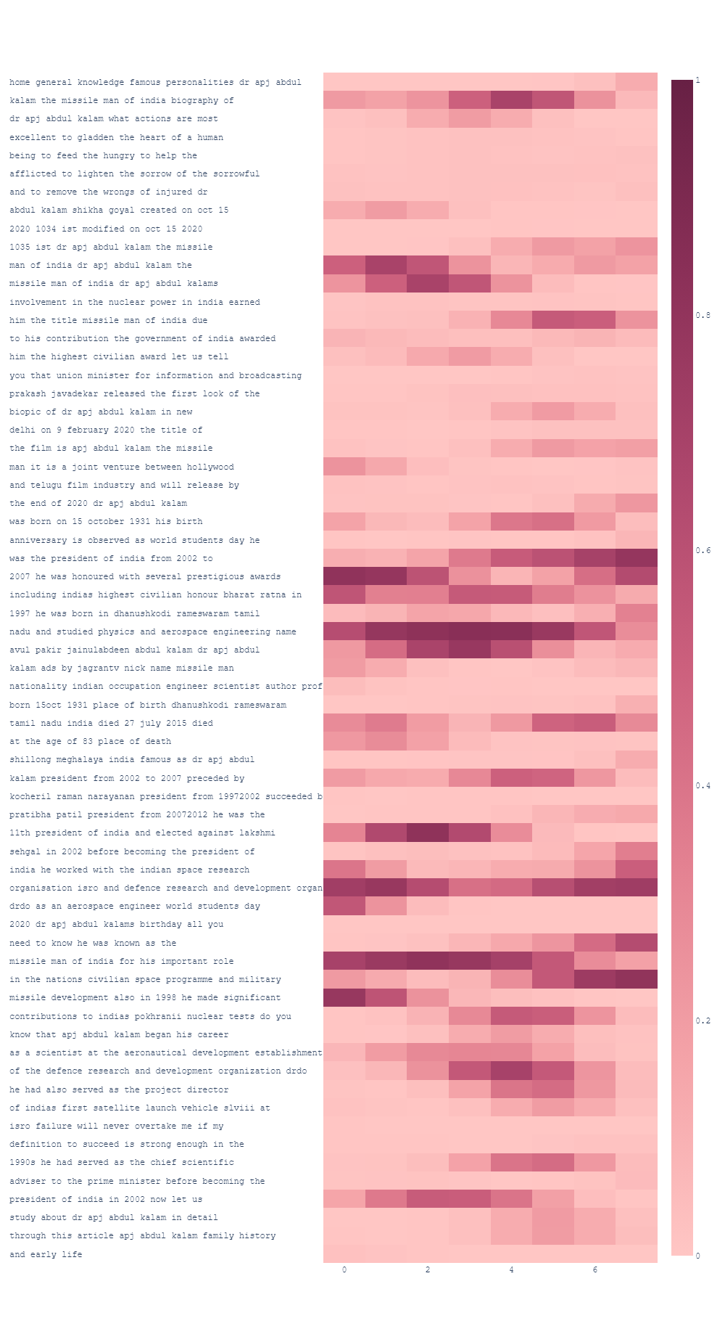
KMP RESULTS
NON-
PLAGIARIZED EXAMPLE
PLAGIARIZED EXAMPLE

Slide 19
CONCLUSION
It is difficult to design pattern matching algorithms, but Finite automata can be used to match strings and regular expressions of all kinds. A Finite Automation accepts regular languages and a language is regular iff it has a regular expression representing it. The study of formal grammar and regular expressions has shown us with those topics the utility, robustness, and sometimes elegance of regular languages. The same approach can also be applied to variety of other functional programming languages. Finally, the use of automata as a symbolic representation for verification has been investigated in other contexts. Based on the pattern and its length the size of the Finite Automata may vary. The Deterministic Finite Automata possibly constructed from the Nondeterministic Finite Automata.

Slide 20
References
[1] http://en.wikipedia.org/wiki/ Automata_theory
[2] Hopcraft J E, Motwani R and Ullman J D [2001], "Introduction to Automata Theory, Languages and Computation", Addison Wesley second edition.
[3] Mindek, M., “Finite State Automata and Image Recognition” DATESO 2004, pp 132-143 (2004), ISBN: 80- 248-0457-3
[4] G. Navarro, R. Baeza-Yates, “Improving an Algorithm for Approximate String Matching.”,Algorithmica, 30(4) 2001
[5] M. Crochemore, T. Lecroq, “Pattern Matching and Text Compression Algorithms”, The Computer Science and Engineering Handbook, A.B. Tucker, Jr, ed., CRC Press, Boca Raton, 2003, Chapter 8.

Slide 21
THANKYOU!

